Slide 1
Object Oriented Analysis & Design Module-5 (RL 5.3.3)
Harvinder S Jabbal

Slide 2
Showing Dependency in Package Diagram

Slide 3
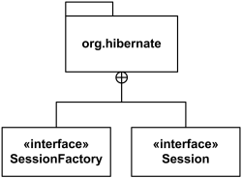
Composition of Packages
A diagram showing a package with content is allowed to show only a subset of the contained elements according to some criterion.
Members of the package may be shown outside of the package by branching lines from the package to the members.
A plus sign (+) within a circle is drawn at the end attached to the namespace (package).
This notation for packages is semantically equivalent to composition (which is shown using solid diamond.)

Slide 4
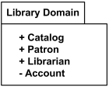
Elements of a Package
The elements that can be referred to within a package using non-qualified names are:
owned elements,
imported elements, and
elements in enclosing (outer) namespaces.
Owned and imported elements may have a visibility that determines whether they are available outside the package.
If an element that is owned by a package has visibility, it could be only public or private visibility.
Protected or package visibility is not allowed.
The visibility of a package element may be indicated by preceding the name of the element by a visibility symbol ("+" for public and "-" for private).
The public elements of a package are always accessible outside the package through the use of qualified names.
All elements of Library Domain package are public except for Account

Slide 5
Packageable element
Some examples of packageable elements are:
Type
classifier (--> type)
class (--> classifier)
use case (--> classifier)
component (--> classifier)
package
constraint
dependency
event
Packageable element is a named element that may be owned directly by a package.

Slide 6
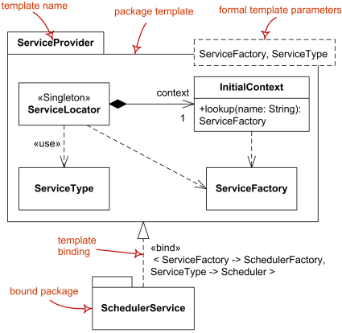
Package Template
Package can be used as a template for other packages. These are called package template and template package.
Packageable element can be used as a template parameter.
A package template parameter may refer to any element owned or used by the package template, or templates nested within it.
A package may be bound to one or more template packages.
When several bindings are applied the result of bindings is produced by taking the intermediate results and merging them into the combined result using package merge.
Package template Service Provider and bound package Scheduler Service.

Slide 7
Acknowledgement
Slides are based on Course Text Books:
Applying UMP and Patterns (An Introduction to Object-Oriented Analysis and Design and Iterative Development) : Craig Larman
UMP Distilled (A Brief Guide to the Standard Object Modeling Langauge) : Martin Fowler
Design Patterns (Elements of Reusable Object-Oriented Software) : Erich Gama | Richard Helm | Rapph Johnson | John Vlissides alias GoF.
Also: http://agilemodeling.com/style/packageDiagram.htm
http://www.uml-diagrams.org/package-diagrams.htm

